Slide 1
Smart Alarm Clock with LED Alerts and Automated Curtain Control
Names 1.

Slide 2
Abstract
This project is an advanced alarm clock system that integrates LED alerts for visual notifications and a servo motor to control curtains.
The core components include an ESP32, DS1302 RTC module, three LEDs, and a servo motor.
alarm system that offers both audio-visual cues and environmental automation (curtain control).

Slide 3
Key Features
LED Notifications Red, Orange, and Green LEDs indicate different stages of the alarm. Orange LED blinks 1 minute before the alarm. Green LED turns on when the alarm triggers.
Automated Curtain Control Servo motor used to automatically open/close the curtains when the alarm is activated.

Slide 4
Components Used
ESP32: The microcontroller used for processing and controlling all components.
DS1302 RTC Module: Provides real-time clock functionality.
3 LEDs:
Red: System Ready
Orange: Alarm is approaching
Green: Alarm activated
Servo Motor: Automates curtain movement when the alarm triggers.

Slide 5
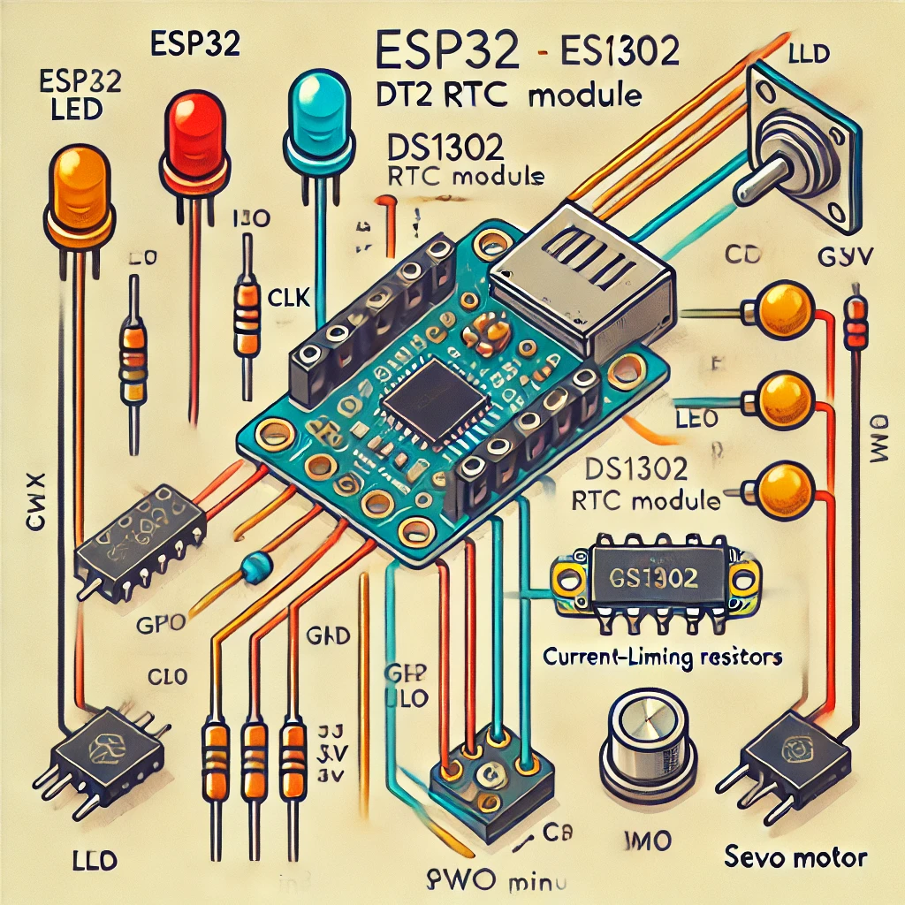
Project Circuit Diagram

Slide 6
Project Flow
Step 1: User sets alarm time through the Serial Monitor.
Step 2: System displays real-time clock on the serial bluetooth output.
Step 3: Orange LED starts blinking 1 minute before the alarm.
Step 4: Green LED turns on and the servo motor activates to open the curtain when the alarm triggers.
Step 5: System resets for the next alarm.

Slide 7
Code Overview
Main Code Functions:
Reading time from the DS1302 RTC.
Setting the alarm time via serial input.
Blinking LEDs for alarm indication.
Triggering the servo motor for curtain control.
Core Logic:
Explain the logic behind time comparison, LED control, and servo activation.

Slide 8
Challenges and Solutions
Challenge 1: Time synchronization between RTC and ESP32.
Solution: Used DS1307 RTC to maintain accurate time.
Challenge 2: Implementing serial communication to set alarm time.
Solution: Used string parsing and validation methods to extract hour and minute values from user input.
Challenge 3: Precise control of the servo motor.
Solution: Implemented proper PWM control and ensured smooth curtain movement.

Slide 9
Future Enhancements
Adding a Buzzer: Integrate a buzzer for an audible alarm.
Mobile App Integration: Control the alarm settings and curtain via Wi-Fi.
Temperature-Based Automation: Use a temperature sensor to adjust curtain movement based on room temperature.

Slide 10
Conclusion
This project successfully combines real-time clock functionality with smart automation.
The LEDs provide clear, visual cues about the alarm status, and the servo motor adds an automated touch to daily life by controlling curtains.

Slide 11
THANK YOU

